Slide 1

Constraint Satisfaction & Search Techniques I
CISC 487 / 680
Applied Artificial Intelligence International Boot Camp
Dr. Majid Shaalan, Chad Van Chu & Brian Grey

Slide 2
What are we doing today?
AI as a search problem and where this fits in AI
Introduction to search
Differences in Search Paradigms
Uninformed Search
Backtracking Search

Slide 3
AI as Search Space Traversal
As mentioned previously, some see AI as totally a problem of moving within a search space
Regression lines aren’t really within AI (applied statistics)
Support vector machines and clustering algorithms organize n-dimensional space into sub-groups
SVMs divide space along hyper planes
Clustering algorithms and recommender systems create subgroups of like elements
Decision trees and forests define data points for decisions
Logic programming is finding chained paths through facts

Slide 4
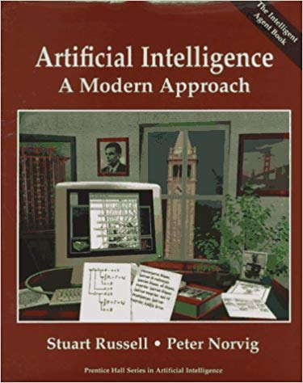
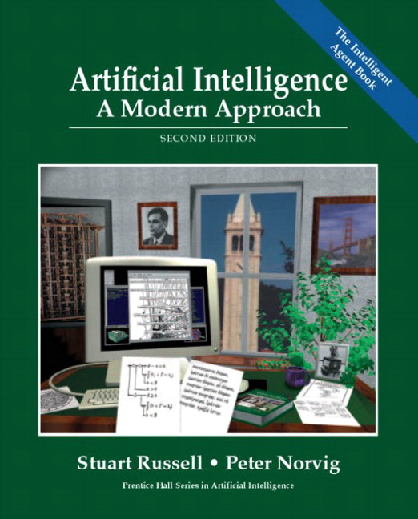

AI as Search Space Traversal
So what’s the next step?
Traditional searching algorithms
Some of this should be review from Essential Algorithms
Russell & Norvig for a “search-based” approach to AI

Slide 5
Why now?
Strong versus weak AI
Much of what you will be looking at in this boot camp will be weak AI
Weak AI is narrow-field, strong AI is general and “understands”
Machine learning techniques find patterns and, at best, can show the paradigm of the patterns
Search and constraint is a much stronger approach
It can understand the topology of the problem space
This has been the classical starting point so it’s good to start here

Slide 6
Intelligent Search Algorithms
These are algorithms which we (people) design and implement
We tell the computer how to traverse the search space
What is the goal of these search algorithms?
Find an element or a path to an element within the search space
What will we need to be able to move in space?
A set of elements and connections between them
A graph
Or a tree
If boiled down to a graph, will every problem be the same?

Slide 7
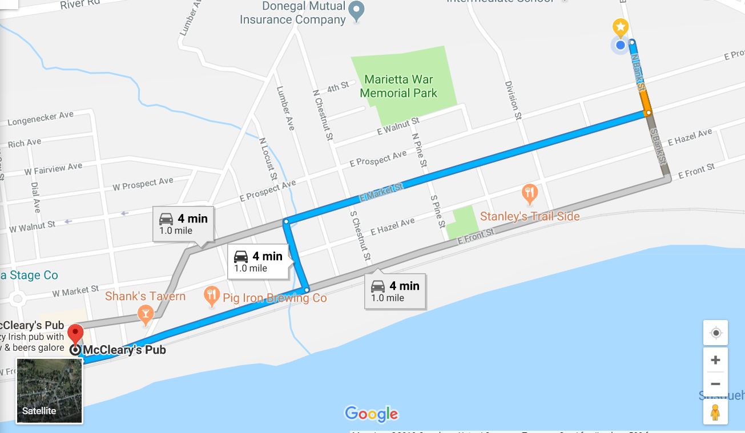
The Classic Example
What is the classic search question?
How do I get somewhere?

Slide 8
The Classic Example (Deconstructed)
What are some observations about this search problem?
Real streets
Euclidean Space with non-zero, non-negative distance
Values between points (intersections) are different
There may be dead-ends on the way
Do I know how the town is laid out?
If I do, I might be able to give a better set of directions
(Or I might be able to get the same directions more efficiently)

Slide 9
Uninformed versus Informed Search
What’s the difference?
Think back to the example of directions
Do you know the town?
Does the algorithm understand the layout of the data?
Efficiency
Informed search more effectively finds the solution
Ease of Implementation
Uninformed algorithms tend to be less complicated
Effectiveness (Which will find the optimal solution?)
Depends on the algorithm/problem space

Slide 10
Uninformed Search
Search algorithms that do not need to understand the search space to operate
Slower but easier to implement
Why?
They don’t need to understand the search space
Examples
Random Walk, Depth-First, Depth-Limited, Breadth-First, Uniform Cost
What else do you notice about all of these?
Sort of brute force, aren’t they?

Slide 11
Wait…
DFS? BFS? Depth limited?
Aren’t those tree searches?
YES!
….And no.
These algorithms can also be used on graphs in a more generalized form

Slide 12
What’s the downside?
What would be the ideal form of any tree?
Think of the directions example
Consider these 2 points:
Would we want to use this path as the edge linking the two of them?
Why not?
Wildly inefficient route
Much better options
Is this specific example likely to happen?

Slide 13
Breadth-First Search
A Classic!
Algorithm:
Add the root to a FIFO queue
While the desired element has not been found and there are still elements in the queue
Dequeue a node
Check children for the desired element or add to the queue

Slide 14
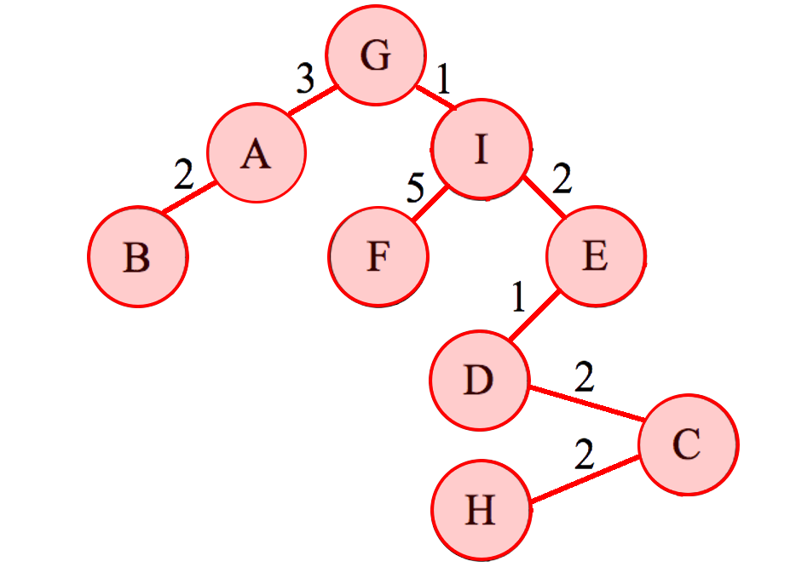
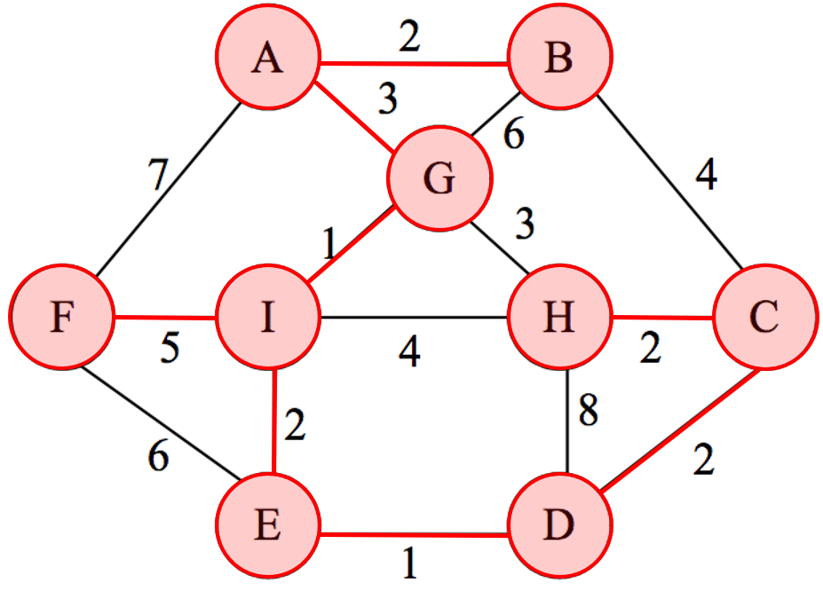
Breadth-First Search Example
Consider:
What are the order of nodes traversed while looking for C?
(We will examine how to create this tree from this graph on Monday.)

Slide 15

Breadth-First Search Analysis
Analysis
Efficiency:
$O(\left|E\right|+\left|V\right|)$
Remember $O(\left|E\right|)$ can be between $O(1)$ and $O\left({\left|V\right|}^{2}\right)$
Complete algorithm
Goal state will always be found
Memory intensive
Weak for deep nodes on wide trees

Slide 16
Depth-First Search
Another Classic!
Algorithm:
Add the root to the list of visited nodes
For all children of the current node
If the child hasn’t been visited, recursively call on child
When is checking of the current node done?
Depends on the type of DFS
Pre-order
In-order
Post-order

Slide 17
Depth-First Search Example
Consider again:
What are the order of nodes traversed while looking for C?
Pre-order
In-order
Post-order

Slide 18

Depth-First Search Analysis
Analysis
Efficiency:
$O(\left|E\right|+\left|V\right|)$
Incomplete algorithm on a graph without node tracking
Can get stuck in an infinite loop
Why/how?
Memory efficient
Weak for wide nodes on deep trees

Slide 19
Depth-Limited/Iteratively Deepening Search
Depth-Limited
DFS where a maximum depth is set
Goal is to prevent cycles of the “graph based” approach
Iteratively Deepening Search
Depth-limited where the maximum depth increases
Seems costly as states and paths will be repeated many times
Why is that mitigated?
Where are most of the nodes?
What is the relative size of a tree/speed of the algorithm at a shallow depth?

Slide 20
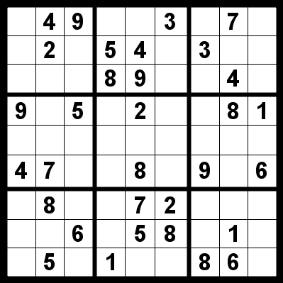
Backtracking Search
Based on constraint satisfaction problems
Math problems that have very specific constraints
Recursively enumerates partial candidate solutions
Each recursive call moves towards a valid or invalid solution
Can be thought of as an improved version of DFS
Example: Sudoku
What is Sudoku?
What are the constraints?
Can you give an example of a manual backtracking search?

Slide 21
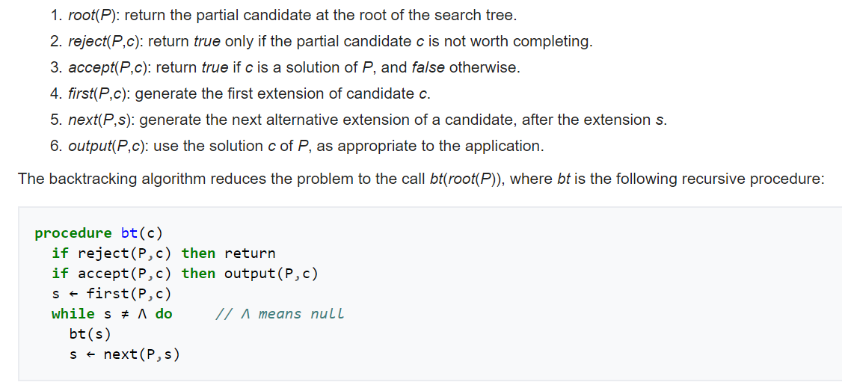
Backtracking Search
Algorithm (I’d type it myself but Wikipedia did a good job):

Slide 22
Backtracking Search Analysis
Analysis:
Base algorithm?
Depth-First Search
Efficiency
Consider: Whole subtrees are skipped
Why continue generating nodes if no element of the subtree can satisfy the constraints?
Cost is determined by the size of the actual search tree and the cost of processing at each node
Cost of processing includes determining solvability

Slide 23
Questions?

